Slide 1
TKGym
By: Tom Tooma, Kyler Cantu, Gianni Menassa

Slide 2
Application Scenario and Problem Statement
A gym has many different aspects that they must keep track of, such as the different equipment, members, vendors, instructors, etc. The application would be utilized to help gym companies keep track of such information in an organized manner.
Member’s also need an application that they can easily navigate through when they want to view details about their accounts or when they want to see what a gym has to offer such as fitness classes that are being held at their gym.

Slide 3
Functional Requirements
Administrators:
View a list that contains every member from all gym locations - READ
Add/Delete new or existing members - INSERT/DELETE
Filter by location - SORT
Modify an existing member’s membership status - UPDATE
Upgrade or Downgrade membership type - UPDATE
View all vendors that supply the gym with equipment - UPDATE
Add/Delete vendors - INSERT/DELETE
View fitness classes that each gym location contains - READ
Add/Delete classes - INSERT/DELETE
Filter by location - SORT
View a list of fitness instructors - READ
Add/Delete fitness instructors - INSERT/DELETE

Slide 4
Functional Requirements Continued
Members:
Create an account/register for a membership if they don’t already have one
Login to their own account
View information regarding their account - READ
Membership type
Registered Classes
Personal Information
View fitness classes that the gym contains -READ
Filter by location - SORT
View Fitness Instructor that teaches the class - READ
View Date/Time for when the classes are - READ
Search and Register/Unregister for classes -SEARCH

Slide 5
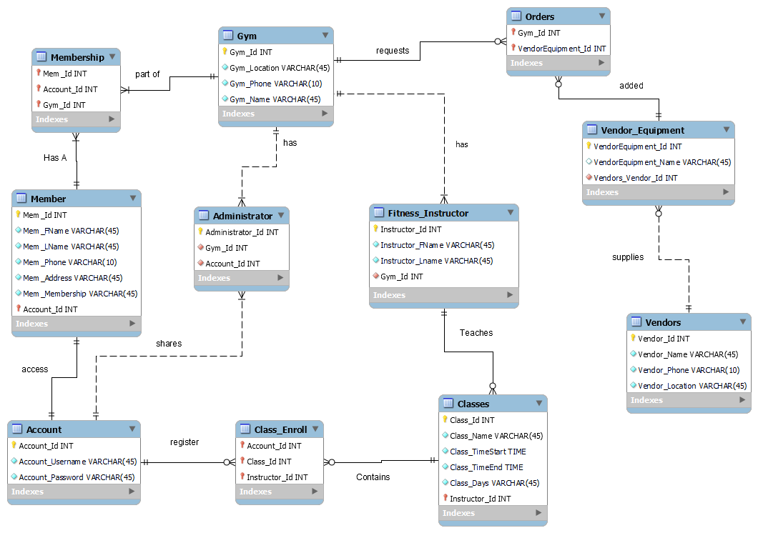
ER-Diagram

Slide 6
Tools Implemented
The tools/languages that were utilized to create the database was MySQL, C#(Sharp) language using the Visual Studio IDE with implemented UI designer (.NET Framework), and MySQL Connector/NET for connecting the UI to the database.
Using Visual Studio’s UI designer, multiple forms were created to help create the different windows that a user/admin will navigate through as they use the application.
By connecting the database to the IDE, through code and the UI, the user/admin is able to read or write attributes or changes to the database.
Utilizing the C#(Sharp) language and the Visual Studio IDE is efficient in creating a structured and simple-to-use user interface where the user/admin can easily navigate through.

Slide 7
Questions?

